Slide 1
Immutability and Selecting ADT’s
CS61B Sp18 Discussion 6

Slide 2
Administrivia
Midterm scores are out!
Regrade requests are Friday the 23rd at noon. No regrades will be accepted later than that.
Please format your regrade according to the format specified on Piazza @1520
Project 2 final version is out
Phase 1 due February 26
Phase 2 due March 5th
It is highly recommended that you find a partner for this project. Partner forms are linked in the spec. Please email jzeitsoff@berkeley.edu if you fill out the form late!
Homework 1 is out and due 2/21
Notes:
Josh Z : added note to email me if they fill out the form late, since I need to run the script to generate their repo etc

Slide 3
Review: Generics
Generics is a way to allow your data structures to work with any type.
public class List<T>{...}
List<String> = new ArrayList<String>();
public static <K, V> V get(Map61B<K, V> map, K key){}
public static <K extends Comparable<K>, V> V get(Map61B<K, V> map, K key){}
This is a generic class
Instantiation
Generic method
Type upper bound
Notes:
For class inheritance, whatever type you instantiate it as, that type will replace the generic type everywhere in the code.
For methods, you must have the generic types in the method signature inside angle brackets.
Type upper bounds restrict the generic type even more by requiring that it is a subclass of a certain class.

Slide 4
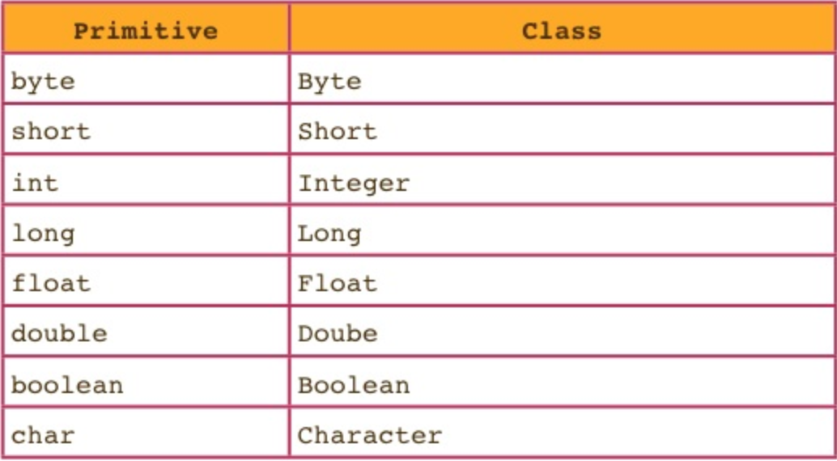
Review: Autoboxing
Every primitive in Java has an Object counterpart. Many data structures cannot hold primitives, so we wrap the primitive in an object.
Java is smart and often converts primitive types to their Object counterparts or Objects to their primitive counterparts automatically. This is called autoboxing.

Slide 5
Review: Exceptions
try{
risky code
} catch (Exception e) {
fix it hurry
} finally {
shut it down
}
Run some code that may throw an exception
Will catch the exception if it is thrown in the try block
Will run no matter what.
Notes:
Try: where you run your code
Anything after the exception might not run!
Catch: where you can handle the exception. This code will only run if an exception is caught.
You must specify the type of exception and also name it something, in this case we name ours “e”
Finally: this will run no matter what. Even if there is an exception that is not caught or a return statement, before the program crashes or returns, the finally block will run
Example: closing a database or stream before it crashes

Slide 6
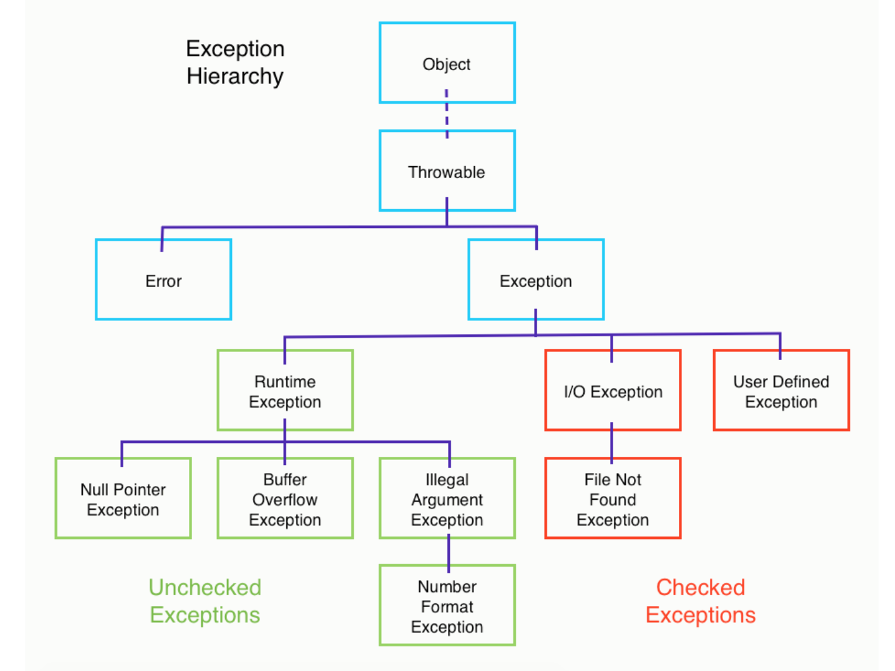
Review: Types of Exceptions
There are 2 overarching types of exceptions:
Checked
You must either wrap them in a try/catch block or pass the buck by using “throws exception” in the method header
Unchecked
You don’t need to handle these. They are typically an error on a user’s part, which can’t really be helped.

Slide 7
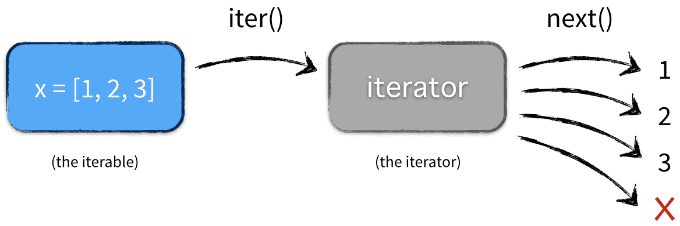
Review: Iterators and Iterables
Iterable: Something that can be iterated over
Must have .iterator() method which creates an iterator
Iterator: actually tool/machine you use to do the iteration.
Must have .next() and .hasNext() methods
Each iterable object will need to produce its own one-use iterator object.
Notes:
Iterator and Iterable are interfaces, just like comparable and comparator. Their high-level concepts are the same too. Iterable is the object which can be iterated over. Iterator is the object that actually does the iterating.

Slide 8




Access Control
Access control allows us to restrict the use of methods, classes, and fields.
private
protected
default (no modifier)
public
Modifier | Class | Package | Subclass | World
public | Y | Y | Y | Y
protected | Y | Y | Y | N
 | Y | Y | N | N
private | Y | N | N | N
Notes:
Private: only usable in the class
Protected: accessible in the class and package and subclasses
Public: anyone can use it
Default: only class and package may use.
Protected is also called “package private”, meaning its the same as private except it can be accessed by the package

Slide 9

Immutability
Immutable: A class or object is immutable if you cannot change anything about it after you instantiate it.
public static final int x = 5;
Caveat: If you instantiate a reference as final, then you are making the reference immutable, but not what is inside the object.
public static final List<String> arr = new ArrayList<String>()
Although arr is declared as final, you can still call arr.insert(“convfefe”).
However, you cannot reassign arr = new LinkedList<String>();
Now, nobody can change the value of x.
Notes:
You’ve probably seen mutable/immutable from 61A. For example, lists are mutable and tuples are immutable.
In Java, you can declare something to be mutable or immutable by using the “final” keyword in its declaration.

Slide 10
Abstract Data Types (Review from disc5)
Abstract data types are defined by their behavior, not by their implementations. AKA, they’re about what, not how.
Some examples are:
List: an ordered collection of elements
Set: an unordered collection of unique elements (no repeats)
Map: a collection of key/value pairs
Stacks: has last in first out property (LIFO)
Queues: has first in first out property (FIFO)
Deques: can be both LIFO and FIFO

Slide 11
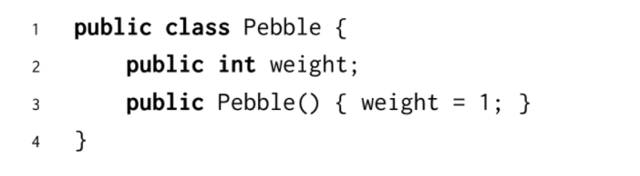
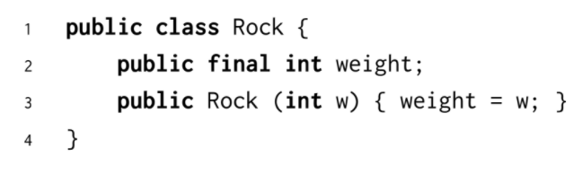
Rocks pt1
Now, nobody can change the value of x.

Slide 12
Rocks pt1
Now, nobody can change the value of x.
Everything in the pebble class is public and non-final. It is mutable.
The Rock class has one int weight and it is declared as final, so it is immutable

Slide 13
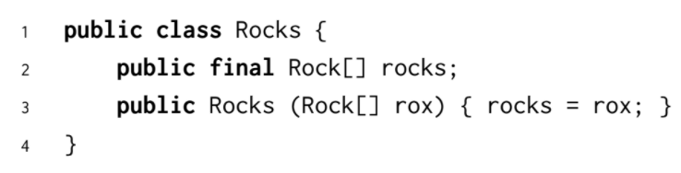
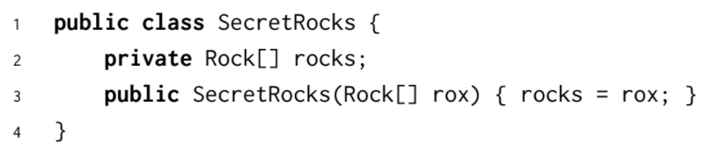
Rocks pt2

Slide 14
Rocks pt2
The rock variable is static, but you can still modify the contents of rocks, thus it is mutable.
There may be a reference to rocks somewhere outside of the class, so it is mutable.

Slide 15
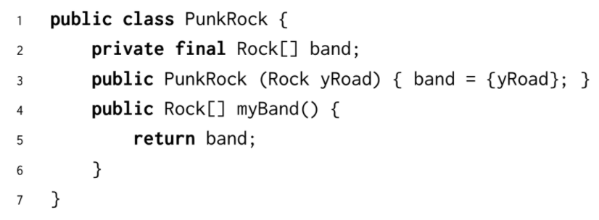
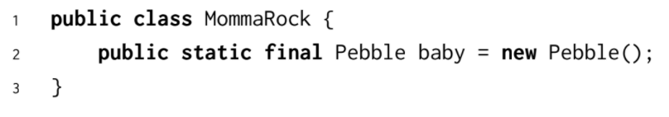
Rocks pt3

Slide 16
Rocks pt3
It is possible to access and modify the contents of PunkRock’s private array through its public myBand() method, so this class is mutable.
This class is mutable since Pebble has public variables that can be changed. For
instance, given a MommaRock mr, you could mutate mr with mr.baby.weight = 5.

Slide 17
2.) Breaking the System pt1
Exploit the flaw by filling in the main method below so that it prints “Success” by causing BadIntegerStack to produce a NullPointerException.

Slide 18
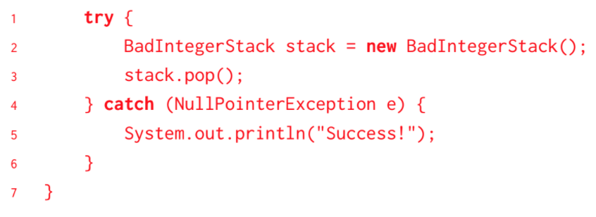
2.) Breaking the System pt1
Exploit the flaw by filling in the main method below so that it prints “Success” by causing BadIntegerStack to produce a NullPointerException.

Slide 19
2.) Breaking the System pt1
Exploit the flaw by filling in the main method below so that it prints “Success” by causing BadIntegerStack to produce a NullPointerException.
The issue is, the bad stack is initialized as empty with top being null. So, if you pop from a newly initialized stack, you will have no “top” variable with which to extract top.value.

Slide 20
2.) Breaking the System pt2
Exploit another flaw in the stack by completing the main method below so that
the stack appears infinitely tall.

Slide 21
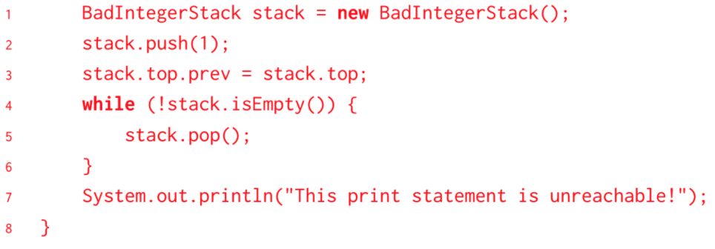
2.) Breaking the System pt2
Exploit another flaw in the stack by completing the main method below so that
the stack appears infinitely tall.

Slide 22
2.) Breaking the System pt2
Exploit another flaw in the stack by completing the main method below so that
the stack appears infinitely tall.
If you set top.prev to itself, then every time you pop you will set top back to itself! This means you can keep popping but top will remain in the list.

Slide 23
2.) Breaking the System pt3
How can we change the BadIntegerStack class so that it won’t throw NullPointerExceptions or allow ne’er-do-wells to produce endless stacks?

Slide 24
2.) Breaking the System pt3
How can we change the BadIntegerStack class so that it won’t throw NullPointerExceptions or allow ne’er-do-wells to produce endless stacks?
Check that top is not null before popping and make top private.

Slide 25
3.) Design a parking lot
Design a ParkingLot package that allocates specific parking spaces to cars in a smart way. Decide what classes you’ll need, and design the API for each. Time permitting, select data structures to implement the API for each class. Try to deal with annoying cases (like disobedient humans).
Parking spaces can be either regular, compact, or handicapped-only.
When a new car arrives, the system should assign a specific space based on the type of car.
All cars are allowed to park in regular spots. Thus, compact cars can park in both compact spaces and regular spaces.
When a car leaves, the system should record that the space is free.
Your package should be designed in a manner that allows different parking lots to have different numbers of spaces for each of the 3 types.
Parking spots should have a sense of closeness to the entrance. When parking a car, place it as close to the entrance as possible. Assume these distances are distinct.
Notes:
There are many solutions for this problem

Slide 26
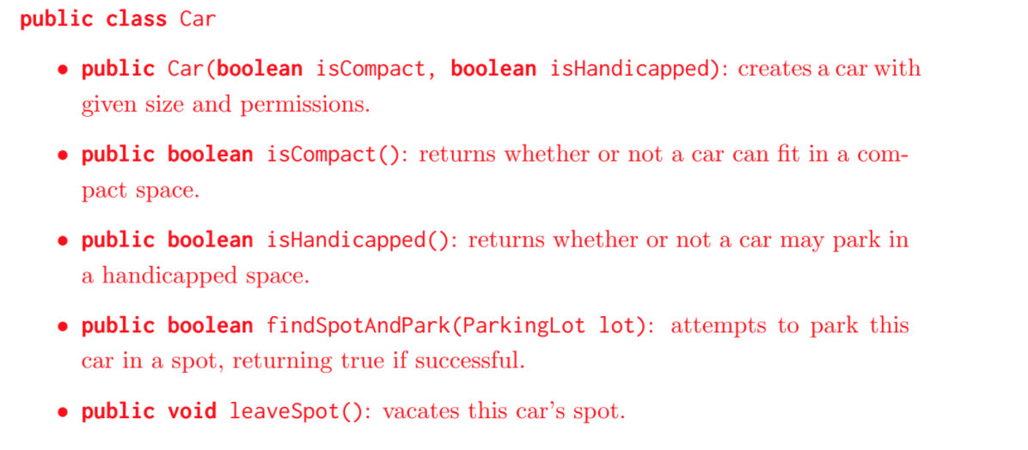
Car

Slide 27
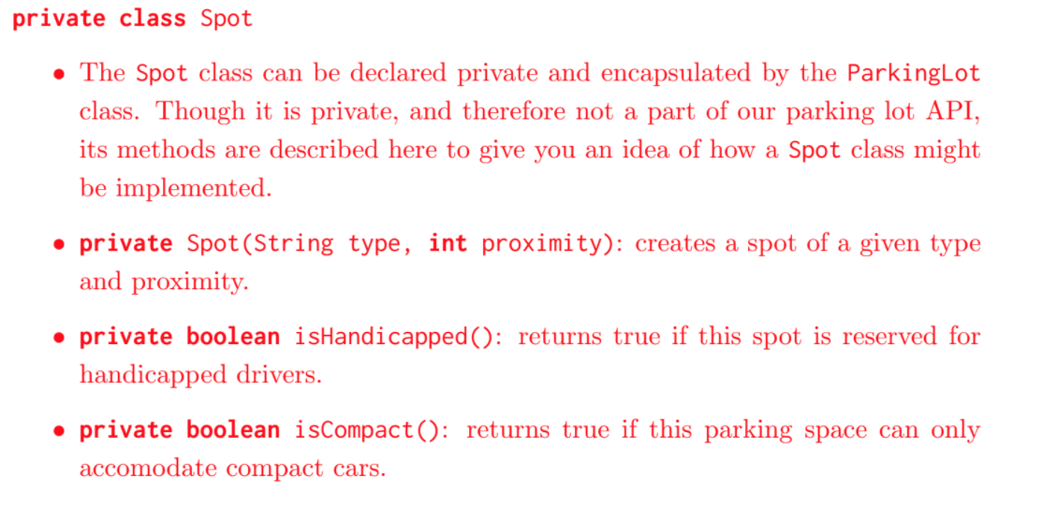
Spot

Slide 28
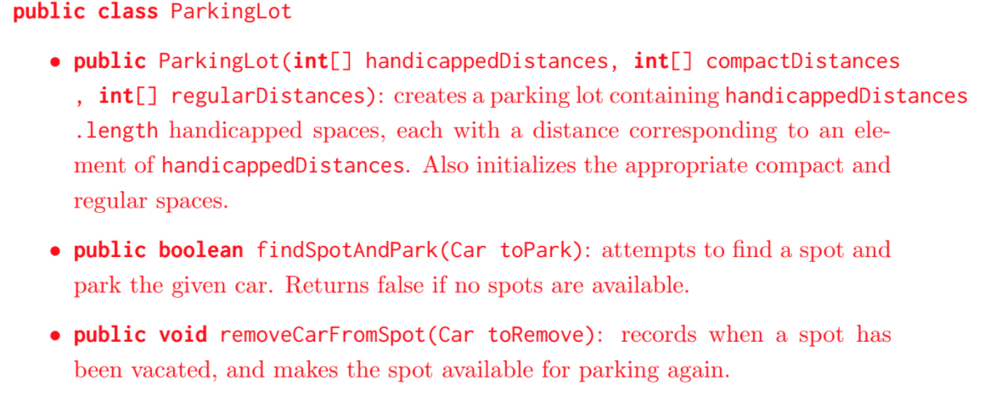
Parking Lot

